Slide 1
Ecommerce Android App Project

Slide 2
Project Analysis SDLC (Software Development Life Cycle)
Requirement Analysis: Identified the need for an ecommerce app with specific components like two activities, a fragment, JSON webservice, a back-end database, and data virtualization.
Design: Designed the system architecture including the database schema, UI/UX design for activities and fragment.
Implementation: Developed the app using Kotlin, integrated Room for database management, and Glide for image loading.
Testing: Conducted functional and integration testing to ensure all components work seamlessly.
Deployment: Prepared the app for deployment, ensuring it meets the project requirements and is ready for submission.
Maintenance: Planned for future enhancements and bug fixes based on user feedback.

Slide 3
Project Analysis(CONTD)
Functional Requirements
The app should display a list of products with images and names.
Users should be able to click on a product to see detailed information.
The app should fetch data from a JSON webservice and store it in a local database.
The app should support basic CRUD operations on the product data.
Non-Functional Requirements
The app should have a user-friendly interface.
The app should be responsive and perform efficiently.
The app should handle data persistence and retrieval seamlessly.
The app should be scalable for future enhancements.

Slide 4
Project Analysis(CONTD)
Objectives
To develop an Android ecommerce app with the required components.
To ensure the app meets both functional and non-functional requirements.
To create a robust and user-friendly interface for displaying product information.
To provide a seamless user experience with efficient data handling and navigation.

Slide 5
Alternative Solution Analysis Pros and Cons of Alternative Technologies/Tools/Solutions
Alternative Database Options:
SQLite:
Pros: Lightweight, widely supported.
Cons: Manual schema management, limited features compared to Room.
Firebase Realtime Database:
Pros: Real-time data synchronization, easy to integrate.
Cons: Requires internet connection, not ideal for local-only applications.
Alternative Image Loading Libraries:
Picasso:
Pros: Easy to use, good for basic image loading.
Cons: Slower and less feature-rich compared to Glide.

Slide 6
Cont’d
Fresco:
Pros: High performance, especially for large images.
Cons: More complex to set up.
Alternative Networking Libraries:
Retrofit:
Pros: Type-safe, easy integration with Gson for JSON parsing.
Cons: Slightly more complex setup than using standard HTTP libraries.
Volley:
Pros: High-level API, easy request scheduling.
Cons: Not as flexible and customizable as Retrofit.

Slide 7
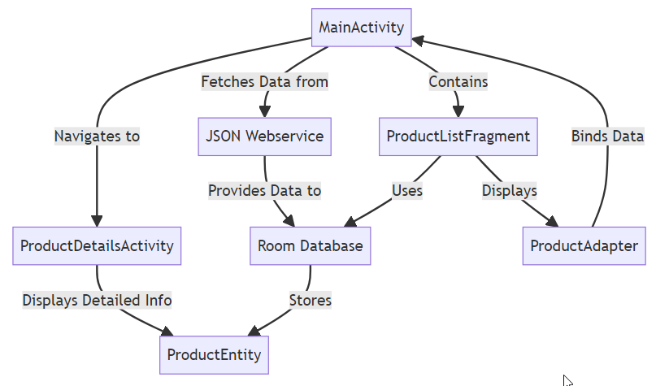
Project Design System Diagram

Slide 8
Project Design(CONTD) Major Components/Modules/Features/Technologies
Activities:
MainActivity: Displays the product list.
ProductDetailsActivity: Shows detailed information about a selected product.
Fragment:
ProductListFragment: Embedded in MainActivity to display the product list.
Database:
Room Database: Manages product data storage and retrieval.
DAO (Data Access Object): Defines methods for accessing the database.
Networking:
JSON Webservice: Fetches product data from a remote source.
Adapters:
ProductAdapter: Binds product data to RecyclerView.
Libraries:
Glide: Loads and displays product images.
Coroutine: Manages asynchronous tasks for database operations.

Slide 9
Project Progress Evaluation Challenges/Risks/Limitations/Trade-offs/Solutions/Discipline
Challenges:
Handling asynchronous database operations.
Ensuring smooth and efficient image loading.
Risks:
Potential data loss if database operations fail.
Performance issues with large datasets.
Limitations:
Limited offline capabilities with real-time data fetching.
Trade-offs:
Choosing Room for its simplicity and features over other databases.
Using Glide for its performance over other image loading libraries.
Solutions:
Utilized Coroutines for efficient asynchronous operations.
Implemented error handling and retry mechanisms for database operations.

Slide 10
Development
Converting Design into a Complete Software System
Coding: Developed the app using Kotlin, adhering to best practices and design patterns.
Compiling: Regularly compiled and tested the app to ensure functionality.
Refining: Refined the app based on testing feedback, optimizing performance and fixing bugs.

Slide 11
Integration and testing
Demonstrating System Conformance to Requirements
Functional Testing: Ensured all features work as expected.
Integration Testing: Verified seamless integration of different components.
User Testing: Conducted tests with sample users to gather feedback.
Test Analysis Reports: Documented test results and identified areas for improvement.

Slide 12
Evaluation and Future work
Project Progress Evaluation and Future Enhancements
Project Progress: Evaluated the overall progress from design to implementation.
Future Enhancements:
Adding user authentication and profiles.
Implementing a shopping cart feature.
Enhancing offline capabilities.
Integrating additional payment options.
Expanding product categories and features.

Slide 13
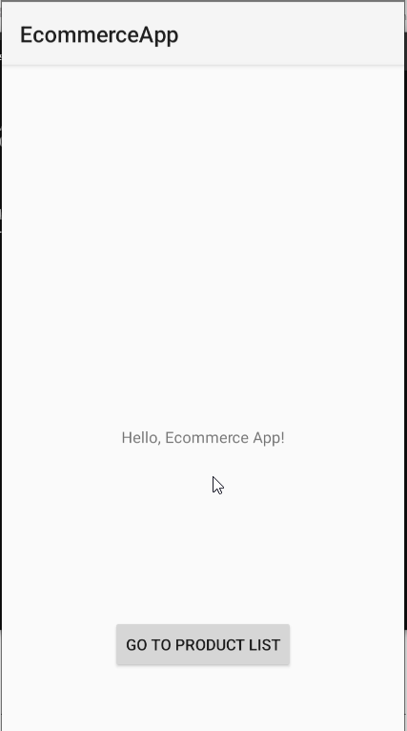
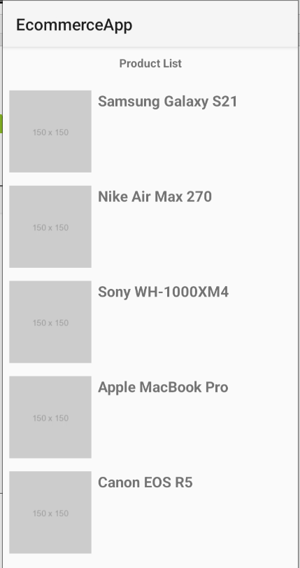
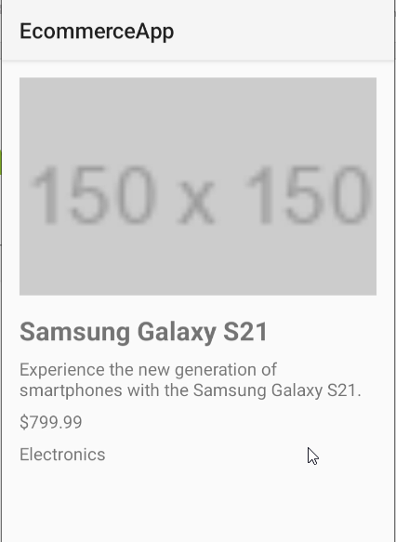
Application screenshots

